Slide 1
The Innovation Culture Canvas
Soren Kaplan
Managing Principal
InnovationPoint
skaplan@innovation-point.com

Slide 2
Every organization is perfectly designed to get the results it gets

Slide 3
Technology
Leadership
Structure
How leaders influence innovation through explicit decisions and subtle behaviors
The formal and informal organizing principles and functional designs that enable (or inhibit) collaboration and guide mindsets & behavior
Capabilities and tools that allow employees, external partners and customers to connect, share knowledge, and innovate
Innovation Culture Canvas
The Business Mission that drives innovation targets & behavior
The mindsets and skillsets of employees, leaders, external partners and even customers tied to creative thinking, prototyping, and execution of new ideas and opportunities
How growth strategies and innovation are executed internally and externally including functional activities, customer engagement, information sharing, product and service development, etc.
The formal and informal measures and rewards that drive and support innovation-related mindsets and behaviors
People
Metrics, Rewards, Recognition
Processes

Slide 4
Technology
Leadership
Structure
___________
___________
___________
___________
___________
___________
___________
___________
___________
Innovation Culture Canvas
The Business Mission that drives innovation targets & behavior
___________
___________
___________
___________
___________
___________
___________
___________
___________
People
Metrics, Rewards, Recognition
Processes

Slide 5
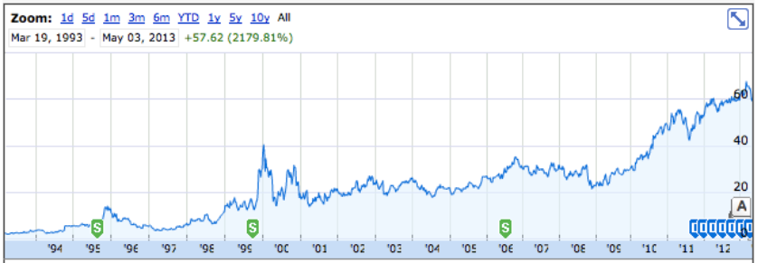
Innovation Catalyst is a true catalyst for growth
Improve Customers’ financial lives so profoundly they can’t imagine going back to the old way

Slide 6
Technology
Leadership
Structure
“Agile Leadership”
Small teams
Experimentation
Prototyping
Storytelling
Catalyst Toolkit
Intuit Brainstorm
Innovator’s Exchange
Autonomous BU’s
100’s of Small Teams
1000’s of intrapreneurs
Innovation Culture Canvas
Improve Customers’ financial lives so profoundly they can’t imagine going back to the old way
200 Innovation Catalysts
All employees given innovation competencies
10% unstructured time
Lean Start-Ins
Customer Office Hours
Founder’s Award
Wall of Fame
Time Reward
Informal Resourcing
People
Metrics, Rewards, Recognition
Processes

Slide 7
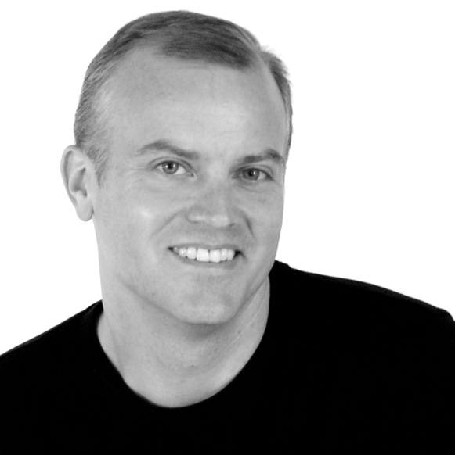
About
Soren Kaplan is a Managing Principal at InnovationPoint, where he works with organizations including Visa, Disney, Colgate-Palmolive, Medtronic, Philips, PepsiCo, and numerous other global firms. Soren previously led the internal strategy and innovation group at Hewlett-Packard (HP) during the roaring 1990’s in Silicon Valley and was a co-founder of iCohere, one of the first web collaboration platforms for online learning and communities of practice.
He is the author of the Wall Street Journal bestselling book Leapfrogging, focused on helping innovative leaders disrupt mindsets and markets.
He is an Adjunct Professor within the Imagineering Academy at NHTV Breda University of Applied Sciences in The Netherlands. He holds Master’s and Ph.D. degrees in Organizational Psychology.
skaplan@innovation-point.com

